Slide 1
Coupa Supplier Portal (CSP) Training

Slide 2
06
How to Set up and Manage Payment Methods

Slide 3
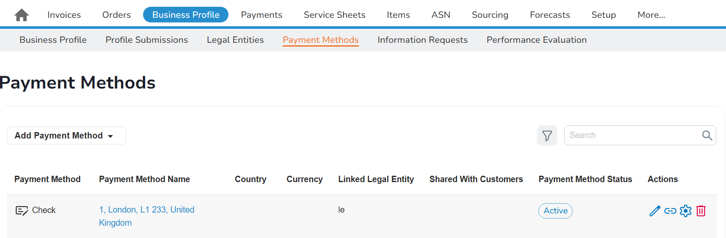
EXAMPLE
How to Set up and Manage Payment Methods (1/2)
1
How to Set up and Manage Payment Methods (1/2)
If you are registering for CSP, once you have created a legal entity, a pop-up window will appear prompting you to add a payment method, including your remit-to information. Please follow steps 3-4 on the next page.
By default, a cheque payment method, with the same legal entity address, will be auto-generated in CSP upon legal entity creation.
To edit an exiting payment method:
Click ‘Business Profile’ tab and the ‘Payment Methods’ sub-tab
Click the pencil icon in the ‘Actions’ column to view and edit the existing payment method.*
2
*Note: In the ‘Actions’ Column, you can also ‘Share Payment Method’, ‘Manage Linked Customers’, and ‘Deactivate Payment Method’.

Slide 4
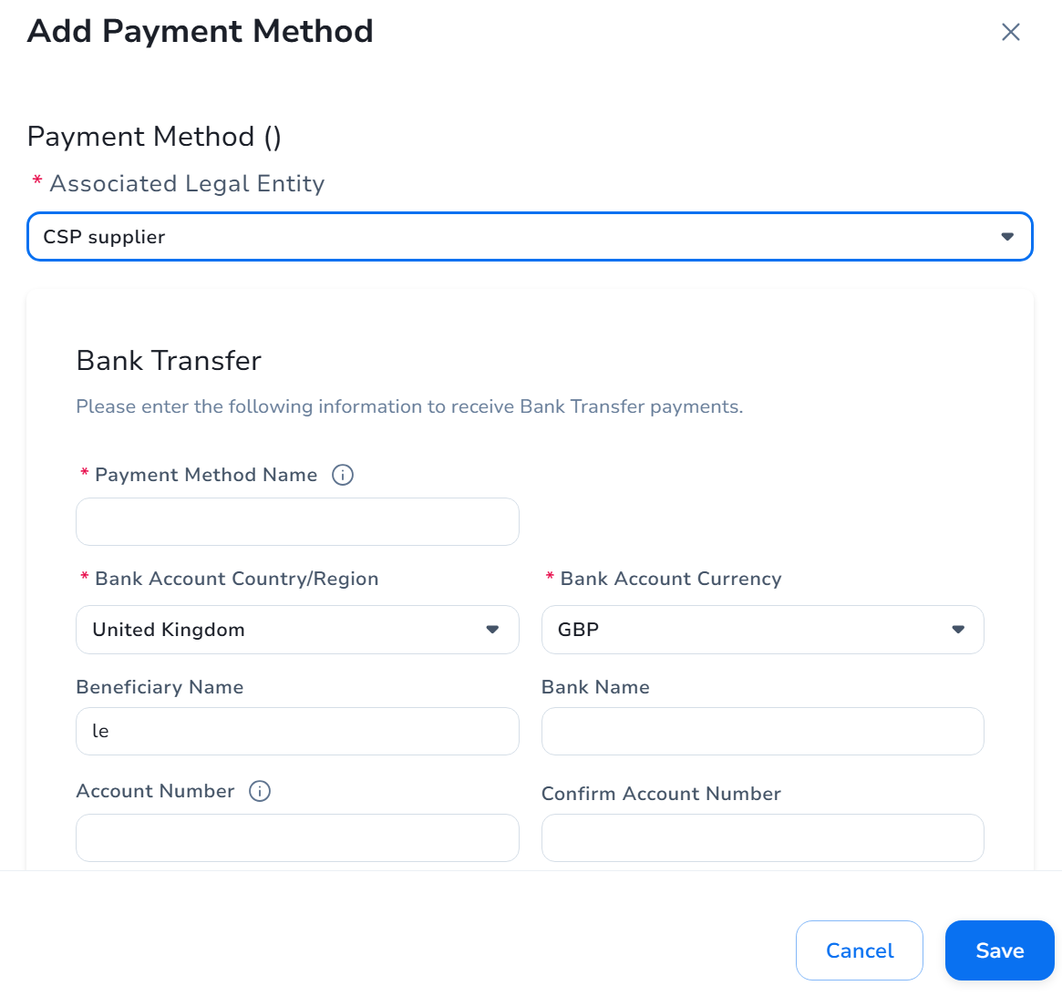
EXAMPLE
How to Set up and Manage Payment Methods (2/2)
1
How to Set up and Manage Payment Methods
(2/2)
To add a new payment method:
Click ‘Business Profile’ tab and the ‘Payment Methods’ sub-tab
Click on the ‘Add Payment Method’ dropdown and select the payment methods
On the ‘Add Payment Method’ page, select the ‘Associated Legal Entity’ and complete all the required fields including payment and remit-to information*
Click on the ‘Save’ button
2
3
*Note: If you are signing up for CSP for the first time, setting up your payment information is not required immediately. However, you must provide this information before you can successfully submit an invoice.
4

